Slide 1
Developing on AWS
Module 9: Processing Your Application Logic
Lab

Slide 2







Agenda
Module 8
Module 9
Module 10
Processing Your Database Operations
Processing Your Application Logic
Managing the APIs
Lab 4
Lab 5
Develop Solutions Using AWS Lambda
AWS Cloud
Develop Solutions Using Amazon API Gateway
AWS Cloud
You
Amazon Polly
You
Amazon API Gateway
Notes:
Module 9 – Compare the feature sets and use cases for available AWS compute solutions. Build an AWS Lambda function to store data from a web application in Amazon DynamoDB.
Lab 4 – Build an AWS Lambda function to store data from a web application in DynamoDB.
Module 10 – Explore the methods available for API Gateway to connect AWS resources.
Lab 5 – Use API Gateway to connect Lambda and DynamoDB.

Slide 3
Module objectives
By the end of this module, you will be able to:
Explore how AWS Lambda works
Develop an AWS Lambda function using SDKs
Configure triggers and permissions for Lambda functions
Test, deploy, and monitor Lambda functions
Notes:
You have worked with the following core services:
Amazon Simple Storage Service (Amazon S3) for storing the data and hosting the website
Amazon DynamoDB to store notes based on the userID
Now, you will use AWS Lambda to process the application logic.

Slide 4
Compute services
Module 9: Processing Your Application Logic

Slide 5




Overview of compute services
Instances
Containers
Serverless
Amazon EC2
Scalable computing capacity
Amazon ECS
Fully managed container orchestration
Amazon EKS
Fully managed container orchestration with Kubernetes
AWS Lambda
Event-driven serverless compute
Abstraction level
Notes:
This lesson explores the options available to manage less when it comes to computing.
Types of computing services
AWS provides three types of computing:
Instances – This is the traditional way of thinking about infrastructure. Instances provide you with complete control of your computing resources. It allows access and customization at deep levels.
Containers – This is one of the most crucial application types in the cloud. The container virtualization systems are smaller, portable, and easier to manage than complete virtual management systems.
Serverless – You do not have to provision servers to run the backend code or worry about the infrastructure model for applications.
Amazon EC2
With Amazon Elastic Compute Cloud (Amazon EC2), you control instances of physical servers. This means that you might need load balancers to distribute the traffic to your instances. Depending on traffic and demand, you may also need to start or stop EC2 instances.
Amazon ECS and Amazon EKS
Amazon Elastic Container Service (Amazon ECS) and Amazon Elastic Kubernetes Service (Amazon EKS) are container orchestration services managed by AWS. A container is a software package that includes your application’s code, configurations, and dependencies. Containers abstract the configuration from your application, which developers can use to create predictable environments that are isolated from other applications. On containers, you can deploy any code, from a complete application to a microservice. You can run Amazon ECS and Amazon EKS clusters on EC2 instances. A cluster is a logical unit grouping of tasks and services that use one or more containers. Amazon ECS and Amazon EKS coordinate these clusters and manage the states of the containers. The services ensure that containers have the resources they need. If one fails, the failure is detected, and another container can replace it.
AWS Lambda
AWS Lambda is an event-driven compute service. An event is a signal that a system’s state has changed. The event invokes a Lambda function to run. Lambda runs on demand. You don’t have to worry about the infrastructure the function runs on, the load balancing, or the scaling aspects of the function. With Lambda, you focus on the code and not the underlying infrastructure. As a result, you can quickly deliver and update your application. You write code for business logic, and AWS manages the infrastructure provisioning or configuration.
You can use any of the AWS compute services to run your code, so choose the one that best fits your needs. This course uses AWS Lambda.

Slide 6
Comparing compute services
Categories | EC2 | ECS /EKS | Lambda
Abstraction | Hardware | Operating system | Runtime
Packaging | Amazon Machine Image (AMI) | Container | Function code
Pricing model | Infrastructure consumption-based | Infrastructure consumption-based | Pay per request
Scalability and concurrency | Full control over configuration and scaling | You control | Implicit scaling
Notes:
Pricing model
The pricing model for Lambda means that you pay per invocation, run duration, and memory used.
Scalability and concurrency
For Amazon EC2, you can provision more instances and increase the size of AMI.
For Amazon EKS and Amazon ECS, you can do the following:
Increase instance size
Add more instances
Add more replicas
Configure load balancing
Configure auto scaling

Slide 7
How AWS Lambda works
Module 9: Processing Your Application Logic

Slide 8








Using Lambda
Event source
Function
Service
Invoke
Optional response
AWS Lambda
Changes in data or resource state
HTTP requests to endpoints
Function code
Internet
API calls through SDK
Notes:
As data flows through your application, Lambda can run code in response to observable events. Lambda runs when it is triggered by an event. Because Lambda can connect to many AWS services, it can run your code in response to the following event sources:
Events, such as a new message in a log file, or changes to data in an Amazon S3 bucket or an Amazon DynamoDB table
HTTP requests using Amazon API Gateway
API calls made using AWS Software Development kits (AWS SDK)
With AWS Lambda, you can run code for virtually any type of application or backend service. The code that AWS Lambda runs is a Lambda function. Lambda functions are stateless. By being stateless, Lambda can quickly scale to the rate of incoming events. Although the AWS Lambda programming model is stateless, your code can access stateful data by calling other web services, such as Amazon S3 or Amazon DynamoDB.

Slide 9













Event sources that invoke AWS Lambda
DATA STORES
ENDPOINTS
Amazon
S3
Amazon DynamoDB
Amazon Kinesis
Amazon Cognito
Amazon API Gateway
AWS
IoT
AWS Step Functions
Amazon Alexa
DEVELOPMENT AND MANAGEMENT TOOLS
EVENT/MESSAGE SERVICES
AWS CloudFormation
AWS
CloudTrail
AWS CodeCommit
Amazon CloudWatch
Amazon EventBridge
Amazon SES
Amazon
SNS
and more!
Notes:
Event sources that invoke AWS Lambda include but are not limited to:
DATA STORES
Amazon S3
Amazon DynamoDB
Amazon Kinesis
Amazon Cognito
ENDPOINTS
Amazon API Gateway
AWS IoT
AWS Step Functions
Amazon Alexa
DEVELOPMENT AND MANAGEMENT TOOLS
AWS CloudFormation
AWS CloudTrail
AWS CodeCommit
Amazon CloudWatch
EVENT/MESSAGE SERVICES
Amazon EventBridge
Amazon SES
Amazon SNS

Slide 10

Anatomy of a Lambda function
Access permissions
Code
Handler function
Other
Runtime (Java, .Net, Node.js, Python…)
+
+ Triggers
Layers (reuse/share code)
Configurations
Concurrency
Memory
Timeouts
Notes:
A Lambda function is a resource that you can invoke to run your code in Lambda.
Prepare your code. The Lambda function code has a handler function and other code. The handler function runs each time an event occurs.
Your code may use runtimes. Lambda supports runtimes for language-specific environments (Node.js, Java, Python, .NET Core, Go, Ruby), or you can create your own custom runtime. A runtime is responsible for the following:
Running the function's setup code
Reading the handler name from an environment variable
Reading invocation events from the Lambda runtime API
Passing the event data to the function handler
Posting the response from the handler back to Lambda
Your code can also use layers that provide shared code or custom runtimes.
The Lambda function requires permissions that define what it can interact with.
A Lambda function must also set up trigger events that specify events or event sources it can interact with. A trigger can be characterized by the following:
An AWS service that is configured to invoke a function
An event source-mapping resource in Lambda that reads items from a stream or queue and invokes a function
You can configure your Lambda runtime environment. You can configure concurrency, memory allocation, timeouts and more.

Slide 11
AWS Lambda invocation models
Module 9: Processing Your Application Logic

Slide 12









Ways to invoke Lambda functions
Synchronous (direct invocation)
Asynchronous (push)
Poll-based (pull)
Amazon S3
Amazon SNS
Amazon Kinesis
Amazon DynamoDB
Amazon API Gateway
Source batch
Source stream
/order
Event queue
Event source mapping
Destination
Destination
✓
✓


Lambda function
Lambda function
Lambda function
Notes:
Synchronous invocation (direct invocation)
When you invoke a function synchronously, Lambda runs the function and waits for a response. The function runs immediately when it is invoked. When the function completes its run, Lambda returns the response from the function's code with additional data. Examples of data include status code and the version of the function that was run. This invocation model does not have build-in retries. You can perform a synchronous invocation from the AWS Management Console, AWS Command Line Interface (AWS CLI), or from the AWS SDKs. Also, many AWS services can invoke Lambda functions synchronously, including Amazon Cognito, Amazon API Gateway, and more.
Asynchronous invocation (Push)
When you invoke a function asynchronously, Lambda sends the event to a queue. A separate process reads events from the queue and runs your function. When the event is added to the queue, Lambda returns one of the following:
A success response without additional information
An error that indicates it cannot add it to the event queue
Lambda manages the function’s asynchronous event queue and makes several attempts to retry on errors. The number of retries and wait between retries is configurable.
You can send an invocation record, which contains details about the request and response, to a destination service, such as the following:
AWS Lambda
Amazon Simple Notification Service (Amazon SNS)
Amazon Simple Queue Service (Amazon SQS)
Amazon EventBridge
Successful and unsuccessful events can have separate destinations. For example, successful invocation records can be sent to an EventBridge event bus, and unsuccessful records can be sent to another event queue.
A best practice for asynchronous invocations is to create and use dead-letter queues to better handle message failures.
Poll-based invocation (pull)
You can configure an AWS Lambda resource to read from a streaming-based or queuing-based event source and invoke your Lambda function. Examples of event sources include the following:
Amazon DynamoDB
Amazon Kinesis
Amazon MQ
Amazon Managed Streaming for Apache Kafka
Self-managed Apache Kafka
Amazon SQS
This is known as event source mapping. It is used to process items from streams or queues in a service that does not normally invoke Lambda functions directly.
As an example, consider DynamoDB. Stream-based invocation changes the traditional way of processing data in batches. Now data may be processed in real-time. DynamoDB Streams capture item-level modifications in real-time and store this information in logs for up to 24 hours. Lambda polls the service, retrieves matching events, and invokes your function. Permissions, event structure, settings, and polling behavior vary by event source.

Slide 13
Function invocation and retries
Invocation | Retries
Synchronous | No retries (Service may retry based on error)
Asynchronous | Built-in retries (2x)
Poll-based | Depends on event source

Slide 14
AWS Lambda runtime lifecycle
Event
Create or unfreeze Lambda runtime environment
Configured resources
Lambda runtime environment
Cold start
Warm start
Download Code
Initialize environment
Invoke
Shutdown
Function
Layers
Extensions
Bootstrap runtime
Run function initialization
Run function handler
Alert extensions
Remove environment
Code
Notes:
To understand how a Lambda function works, consider the following:
Trigger – Events that invoke the call. You can set up your code to initiate from other AWS services automatically or call it directly from any web or mobile app.
Code – Upload your code as a Lambda function, or directly code in the Lambda’s code editor. The code can be in any of the supported languages or use custom runtimes and native libraries. AWS Lambda stores code in Amazon S3 and encrypts it at rest.
Configuration – When you create the function, specify configuration information such as permissions, resources, credentials, and environment variables.
Extensions – Integrate Lambda with existing tools, such as tools used for monitoring, observability, security, and governance.
Lambda runtime environment – Lambda invokes your function in a secure and isolated container created according to resources defined by the configuration. Lambda then loads into memory the code that is to be run. This Lambda runtime environment manages the resources required to run your function and supports the lifecycle of the function’s runtime. The process of creating and mounting the environment is called a cold start. After the environment is set up, Lambda retains the environment and handles requests. The invocation of a Lambda function after the environment exists (with its layers, initialization, and runtime setup) is known as a warm start.

Slide 15
Concurrency
Event
Event
Event
Event
Event
Cold start
Invoke
Invoke
Inactivity period
Shutdown
Cold start
Invoke
Invoke
Invocations are routed to a Lambda runtime environment, or a new environment is created.
Cold start
Invoke
Notes:
New invocation requests are processed with a Lambda runtime environment that is available. If a runtime is not available or if an environment is busy, a new runtime is created to handle the request. This new runtime does not share resources with other Lambda runtime environments.
A runtime may not be available if it has shut down because an event has not come in for some time.
All requests are limited to 15 minutes (900 seconds) of running time. The default timeout is 3 seconds but can be set to any value between 1 and 900 seconds. Duration is calculated from the time your code begins running until it returns or otherwise terminates, rounded up to the nearest millisecond.

Slide 16

Minimize cold starts
Warm start (waiting for events)
EventBridge Event (time-based trigger)
Schedule a Lambda function
Create a rule to run a function at a specific interval
Provisioned concurrency
Initialize the specified number of Lambda runtime environments
Notes:
|
To avoid a cold start, you can set triggers for your Lambda function.
Also, you can use the Provision Concurrency feature in Lambda to prepare multiple Lambda runtime environments to process events.
For more information on scheduling a Lambda function, see (https://docs.aws.amazon.com/eventbridge/latest/userguide/eb-run-lambda-schedule.html)

Slide 17
Permissions
Module 9: Processing Your Application Logic

Slide 18
Permissions overview
Invocation permissions
Grant event sources permission to invoke Lambda
Update the access policy associated with your Lambda function
Use the Lambda AddPermission API
Processing permissions
Grant AWS Lambda permission to read from the stream
Update the execution role
Notes:
Types of permissions related to Lambda functions:
Invocation permissions – Permissions that the event source needs to communicate with your Lambda function. Depending on the invocation model (push or pull model), you can grant these permissions using the execution role or resource policies (the access policy associated with your Lambda function).
Processing permissions – Permissions that your Lambda function needs to access other AWS resources in your account. You grant these permissions by creating an AWS Identity and Access Management (IAM) role, known as an execution role.

Slide 19



Push or direct invocation model
1. Push events to AWS Lambda, or invoke the Lambda function directly.
2. Process the event.
IAM execution role
Resource policy
Event source
Service
Access policy
Notes:
Resource policy - gives other accounts and AWS services permission to use your Lambda resources.
IAM execution role - Grants the function permission to access AWS services and resources.
Access policy - Grants the needed resource permissions.
The entity that invokes your Lambda function must have permission to do so. The event source (such as Amazon S3 or a user-defined application) invokes your Lambda function by publishing events.
You grant these event sources permissions to invoke your Lambda function by updating the access policy associated with your Lambda function.
AWS Lambda provides the AddPermission API for this purpose.
Note: If the user-defined application and the Lambda function it invokes belong to the same AWS account, you don’t need to grant explicit permissions.
For more information, see the following in the AWS Lambda Developer Guide:
“AddPermission” (http://docs.aws.amazon.com/lambda/latest/dg/API_AddPermission.html)
“AWS Lambda permissions” (http://docs.aws.amazon.com/lambda/latest/dg/intro-permission-model.html)

Slide 20
Pull or polling invocation model
1. Poll event sources.
2. Process the event.
IAM execution role
IAM execution role
Event source
Service
Resource policy
Resource policy
Notes:
In the pull event model, AWS Lambda polls the event source and invokes your Lambda function when it detects an event. This model applies when AWS Lambda is used with streaming event sources such as Amazon Kinesis and Amazon DynamoDB Streams. For example, AWS Lambda polls your Kinesis data stream or DynamoDB stream and invokes your Lambda function when it detects new records on the stream. You must grant AWS Lambda permission to read from the stream. You do this by updating the IAM execution role associated with your Lambda function.
In this model, AWS Lambda manages the event source mapping. That is, it provides an API for you to create event source mappings that associate your Lambda function with a specific event source.
For more information, see “CreateEventSourceMapping” in the AWS Lambda Developer Guide (http://docs.aws.amazon.com/lambda/latest/dg/API_CreateEventSourceMapping.html).

Slide 21
Develop
Module 9: Processing Your Application Logic

Slide 22

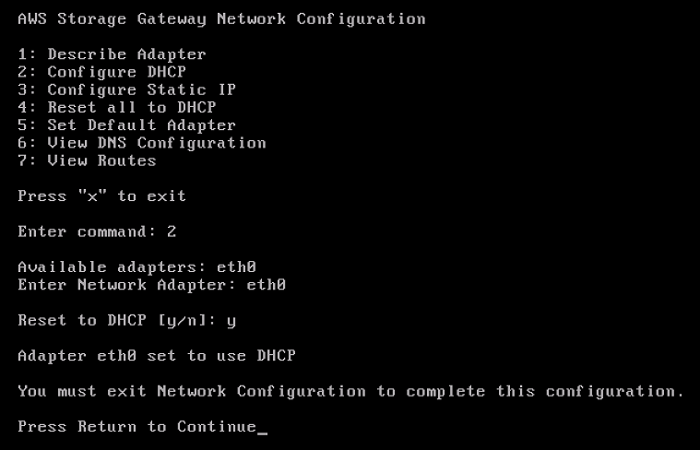
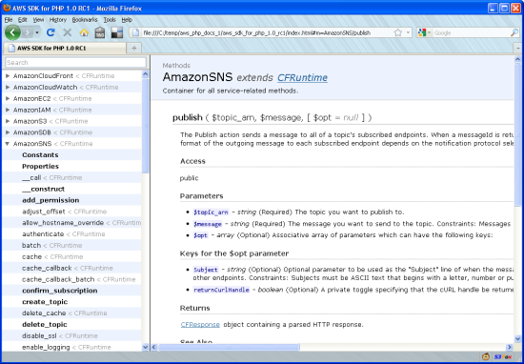

Developing options
Accessible from
AWS Management Console
AWS Command Line Interface (AWS CLI)
AWS Software Development Kits (SDKs)
AWS Cloud9
WYSIWYG editor, or upload packaged .zip file
Third-party plugins (Eclipse, PyCharm, Visual Studio)
Development Tools
Notes:
For more information on development tools, see:
“Using Lambda with the Toolkit for Eclipse” in the AWS Toolkit for Eclipse User Guide (http://docs.aws.amazon.com/AWSToolkitEclipse/latest/GettingStartedGuide/lambda.html)
AWS Lambda Developer Guide: AWS Toolkit for Visual Studio (https://docs.aws.amazon.com/lambda/latest/dg/csharp-package-toolkit.html)
AWS Toolkit for PyCharm in the Jet Brains Marketplace (https://plugins.jetbrains.com/plugin/11349-aws-toolkit)

Slide 23



Planning a Lambda function
Programming model
Stateless
Monitoring and logging
Use processes, threads, /tmp, sockets
AWS SDKs
Persist data using external storage
No affinity or access to underlying infrastructure
Metrics for requests, errors, and throttles
Built-in logs to Amazon CloudWatch Logs
AWS X-Ray integration
Notes:
Programming model
With AWS Lambda, you can use normal language and operating system features, such as creating additional threads and processes.
AWS SDKs provide language-specific APIs and manage many of the connection details. The runtimes for Python and Node.js have the SDKs built in, so you do not have to bundle those SDKs with your code.
Stateless
Keep your Lambda functions stateless. By doing this, AWS Lambda rapidly launches as many copies of the function as needed to scale to the rate of incoming events. Although the AWS Lambda programming model is stateless, your code can access stateful data by calling other web services, such as Amazon S3 or Amazon DynamoDB.
Monitoring and logging best practices
Use AWS Lambda metrics and CloudWatch alarms instead of creating or updating a metric from within your Lambda function code. It's a much more efficient way to track the health of your Lambda functions. You can catch issues early in the development process. For instance, you can configure an alarm based on the expected duration of your Lambda function runtime to address any bottlenecks or latencies attributable to your function code.
Use your logging library and AWS Lambda metrics and dimensions to catch application errors (for example, ERR, ERROR, WARNING).

Slide 24
Lambda function: Handler
Event object Data sent during invocation
Handler function Code to be run upon invocation
Context object Provides information about the current runtime environment
Notes:
|
Handler
When a Lambda function is invoked, the handler code runs. The handler is a specific code method (Java, C#) or function (Node.js, Python) that you’ve created and included in your package. You specify the handler when creating a Lambda function. Each language that Lambda supports has its own requirements for how a function handler can be defined and referenced within the package.
A handler receives two arguments:
Event object
When your Lambda function is invoked in one of the supported languages, one of the parameters provided to your handler function is an event object. The event differs in structure and contents, depending on which event source created it. The contents of the event parameter include all of the data and metadata your Lambda function needs to drive its logic. For example, an event that the API Gateway creates will contain details related to the HTTPS request that was made by the API client. Details include path, query string, request body. By contrast, an event created by Amazon S3 when a new object is created includes details about the bucket and the new object.
Context object (optional) Your Lambda function is also provided with a context object. The context object allows your function code to interact with the Lambda runtime environment. The contents and structure of the context object vary, based on the language runtime your Lambda function is using. However, at a minimum, it will contain the following elements:
AWS RequestId – Used to track specific invocations of a Lambda function (important for error reporting or when contacting AWS Support).
Timeout – The amount of time in milliseconds that remain before your function timeout occurs. (Lambda functions can run a maximum of 900 seconds as of this publishing, but you can configure a shorter timeout.)
Logging – Each language runtime provides the ability to stream log statements to CloudWatch Logs. The context object contains information about which CloudWatch Logs stream your log statements will be sent to.
Best practices:
Separate the Lambda handler (entry point) from your core logic
You can make a more unit-testable function.
Avoid using recursive code Avoid using recursive code in your Lambda function, wherein the function automatically calls itself until some arbitrary criteria is met. This could lead to unintended volume of function invocations and escalated costs. If you do accidentally do so, set the function concurrent runtime limit to 0 immediately to throttle all invocations to the function while you update the code.

Slide 25
Example: Amazon S3 event
{ "Records": [ { "eventVersion": "2.1",
"eventSource": "aws:s3",
"awsRegion": "us-east-2",
"eventTime": "2019-09-03T19:37:27.192Z",
"eventName": "ObjectCreated:Put",
"userIdentity": { "principalId": "AWS:AIDAINPONIXQXHT3IKHL2" },
"requestParameters": { "sourceIPAddress": "205.255.255.255" },
"responseElements": { "x-amz-request-id": "D82…", "x-amz-id-2": "vl…=" },
"s3": { "s3SchemaVersion": "1.0", "configurationId": "828…",
"bucket": { "name": "notes-bucket",
"ownerIdentity": { "principalId": "A3I…" },
"arn": "arn:aws:s3:::lambda-artifacts-dea…" },
"object": { "key": "b2…", "size": 1305107, "eTag": "b21…", "sequencer": "0C0F6F405D6ED209E1" }
}}}]}
The format of the event, and the payload it carries, depends on the AWS service that invokes your function.
The event sent from Amazon S3 contains details about the object uploaded to Amazon S3.

Slide 26
Context
Methods and properties that provide information about the current runtime environment
Context methods (Java)
getRemainingTimeInMillis()
getFunctionName()
getFunctionVersion()
getInvokedFunctionArn()
getMemoryLimitInMB()
getAwsRequestId()
getLogGroupName()
getLogStreamName()
getIdentity()
getClientContext()
getLogger()
Notes:
Python
Context methods
get_remaining_time_in_millis – Returns the number of milliseconds left before the lambda-run time limit is reached (default = 3 seconds).
Context properties
function_name – The name of the Lambda function.
function_version – The version of the function.
invoked_function_arn – The Amazon Resource Name (ARN) that's used to invoke the function. Indicates if the invoker specified a version number or alias.
memory_limit_in_mb – The amount of memory that's allocated for the function.
aws_request_id – The identifier of the invocation request.
log_group_name – The log group for the function.
log_stream_name – The log stream for the function instance.
Java:
Context methods
getRemainingTimeInMillis() – Returns the number of milliseconds left before the lambda-run time limit is reached (default = 15 minutes).
getFunctionName() – Returns the name of the Lambda function.
getFunctionVersion() – Returns the version of the function.
getInvokedFunctionArn() – Returns the Amazon Resource Name (ARN) that's used to invoke the function. Indicates if the invoker specified a version number or alias.
getMemoryLimitInMB() – Returns the amount of memory that's allocated for the function.
getAwsRequestId() – Returns the identifier of the invocation request.
getLogGroupName() – Returns the log group for the function.
getLogStreamName() – Returns the log stream for the function instance.
getIdentity() – (mobile apps) Returns information about the Amazon Cognito identity that authorized the request.
getClientContext() – (mobile apps) Returns the client context that's provided to Lambda by the client application.
getLogger() – Returns the logger object for the function.
.NET (C#)
Context properties
FunctionName – The name of the Lambda function.
FunctionVersion – The version of the function.
InvokedFunctionArn – The Amazon Resource Name (ARN) that's used to invoke the function. Indicates if the invoker specified a version number or alias.
MemoryLimitInMB – The amount of memory that's allocated for the function.
AwsRequestId – The identifier of the invocation request.
LogGroupName – The log group for the function.
LogStreamName – The log stream for the function instance.
RemainingTime (TimeSpan) – Returns the number of milliseconds left before the lambda-run time limit is reached (default = 15 minutes).
Identity – (mobile apps) Information about the Amazon Cognito identity that authorized the request.
ClientContext – (mobile apps) Client context that's provided to Lambda by the client application.
Logger – The logger object for the function.

Slide 27
Example: Function handler (Python)
def handler_name(event, context):
...
return some_value
Example
def my_handler(event, context):
message = 'Hello {} {}!'.format(event['first_name'],
event['last_name'])
return {
'message' : message
}
Notes:
Handler is a function that calls to start your AWS Lambda function. AWS Lambda passes any event data to the handler function as the first parameter. Your handler processes the event data and may invoke any other functions or methods in your code.
This example has one function called my_handler. The function returns a message that contains data from the event it received as input.

Slide 28
Example: Function handler (Java)
MyOutput output handlerName(MyEvent event, Context context)
{
...
}
Example
package example;
import com.amazonaws.services.lambda.runtime.Context;
import com.amazonaws.services.lambda.runtime.RequestHandler;
public class Hello implements RequestHandler<Integer, String>{
public String myHandler(int myCount, Context context) {
return String.valueOf(myCount);
}
}
Notes:
In this example, input is of type Integer, and output is of type String. If you package this code and dependencies and create your Lambda function, you specify example.Hello::myHandler (package.class::method-reference) as the handler.
In the example Java code, the first handler parameter is the input to the handler (myHandler), which can be any of the following:
Event data (published by an event source, such as Amazon S3)
Custom input you provide, such as an Integer object (as in this example) or any custom data object

Slide 29
Example: Function handler (C#)
myOutput HandlerName(MyEvent event, ILambdaContext context) {
...
}
Example
using System.IO;
namespace Example
{
public class Hello
{
public Stream MyHandler(Stream stream)
{
// function logic
}
}
}
Notes:
When you create a Lambda function, you specify a handler that AWS Lambda can invoke when the service runs the function for you. You define a Lambda function handler as an instance or static method in a class. If you want access to the Lambda context object, it is available by defining a method parameter of type ILambdaContext. This parameter is an interface that you can use to access information about the current run, such as the following:
Name of the current function
Memory limit
Runtime remaining
Logging
In the example C# code, the first handler parameter is the input to the handler (MyHandler). The input can be event data (published by an event source, such as Amazon S3). It can also be custom input that you provide, such as a stream (as in this example), or any custom data object. The output is of type Stream.

Slide 30
Example: Lambda function (Python)
# Initializations outside of handler to make a more unit-testable function dynamoDBResource = boto3.resource('dynamodb')
pollyClient = boto3.client('polly')
s3Client = boto3.client('s3')
def lambda_handler(event, context):
# Extract the user parameters from the event and environment
userId = event['userId']
noteId = event['noteId']
voiceId = event['voiceId']
mp3Bucket = os.environ['MP3_BUCKET_NAME']
ddbTable = os.environ['Notes_Table']
# Get the note text from the database
text = getNote(dynamoDBResource, ddbTable, userId, noteId)
# Save an MP3 file locally with the output from polly
filePath = createMP3File(pollyClient, text, voiceId, noteId)
# Host the file on S3 that is accessed by a presigned url
signedURL = hostFileOnS3(s3Client, filePath, mp3Bucket, userId, noteId)
return signedURL
Pull info from event.
Pull info from environment variables.
Separate the Lambda handler from your core logic.

Slide 31
Environment variables
Use
Adjust the behavior of a Lambda function without updating its code
Storage
Stored in a function's version-specific configuration and made available to the function
Encrypted at rest
Terminal X
>>aws lambda update-function-configuration --function-name my-function \
--environment "Variables={BUCKET=my-bucket,KEY=file.txt}"
Notes:
|
Use environment variables to pass operational parameters to your function.
For example, if you are writing to an S3 bucket, instead of hardcoding the bucket name that you are writing to, configure the bucket name as an environment variable.

Slide 32
Using Lambda API
CreateFunction
Create a Lambda function through a deployment package
Package type can be a ZIP or a container image
UpdateFunctionCode
Update the code of the Lambda function
Code must be unpublished
UpdateFunctionConfiguration
Modify the version-specific settings of the Lambda function
Invoke
Invokes a Lambda function synchronously or asynchronously

Slide 33
Create a Lambda function (AWS CLI)
Terminal X
>> aws lambda create-function --function-name dictate-function --handler app.lambda_handler
--runtime python3.8 -–role arn:aws:iam::563926481938:role/lambdaPollyRole --environment Variables={TABLE_NAME=$notesTable} --zip-file fileb://dictate-function.zip
{ "LastUpdateStatus": "Successful",
"FunctionName": "dictateABC",
"LastModified": "2021-08-18T20:46:28.341+0000",
"RevisionId": "a76cada1-ee56-4b0b-924e-d2c38fbdf9ab",
"MemorySize": 128,
"Environment": { "Variables": { "TABLE_NAME": "Notes" } },
"State": "Active",
"Version": "$LATEST",
"Role": "arn:aws:iam::563926481938:role/lambdaPollyRole",
"Timeout": 3,
"Handler": "app.lambda_handler",
"Runtime": "python3.8",
"TracingConfig": { "Mode": "PassThrough" },
"CodeSha256": "Oow63xlj1nCVbbfY2rJGTjAAclBrufctZxzjfXt0MOU=",
"Description": "",
"CodeSize": 1273,
"FunctionArn": "arn:aws:lambda:us-west-2:563926481938:function:dictateABC",
"PackageType": "Zip"}
Notes:
|
This example creates a Lambda function for python3.8 from a .zip file and specifies the handler function. The command uses the IAM role: lambdaPollyRole. An environment variable is set.

Slide 34
Update the function configuration (AWS CLI)
Terminal X
>> aws lambda update-function-configuration --function-name dictate-function
--environment Variables="{MP3_BUCKET_NAME=$apiBucket,Notes_Table=$notesTable}"
{
"FunctionName": "dictate-function",
. . .
"Environment": {
"Variables": {
"MP3_BUCKET_NAME": "labstack-ykantos-qbtxaus339lj-pollynotesapibucket",
"Notes_Table": "pollynotes_table"
}
},
. . . }
Notes:
|
With update-function-configuration, you can change the configuration details of the AWS Lambda function, such as memory, timeout, environment variables, and more.

Slide 35
Control the runtime environment with versions and aliases
Event source
stageVariables.useAlias = Test
Amazon API Gateway
Substitute your stage variable ${} at runtime.
arn:aws:lambda:aws-region:acct-id: function:dictate-function:${stageVariable.useAlias}
Aliases to a specific Lambda version.
Version 1
arn:aws:lambda:aws-region:acct-id:function:dictate-function:Prod
The production environment remains stable.
The Test alias is associated with the latest Lambda function version.
Version 2
Version $Latest
arn:aws:lambda:aws-region:acct-id:function:dictate-function:Test
Delete Lambda functions that you are no longer using.
Notes:
Lambda functions are versioned. When you publish a new version, the version number is incremented, and the earlier version is stored. You can publish one or more versions of your Lambda function. Each version has a unique ARN.
You can use aliases to invoke specific versions of the function. A Lambda alias is like a pointer to a specific function version. Aliases can be updated to point to other versions.
In the example shown on the slide, the Lambda function has version 1, version 2, and $latest. Each version has its unique ARN. Services need to use the correct version of the Lambda function. This is where aliases can help. A Lambda alias can point to a function version that is configured with environment variables, and so avoiding hard-coding specific versions into your application. For example, the test team can use arn:aws:lambda:aws-region:acct-id:function:dictate-function:Test , where Test is an alias associated with a specific Lambda version. And the production team can use arn:aws:lambda:aws-region:acct-id:function:dictate-function:Prod , where Prod is an alias associated with a specific Lambda version.
AWS CLI command:
Publish new version of a Lambda function: aws lambda publish-version --function-name my-function
Create alias for the lambda function: aws lambda create-alias --function-name my-function --name alias-name --function-version version-number --description " “

Slide 36
Share code with layers
My_Function_V1
My_Function_V2
Dependencies are part of the deployment package
1-MB business logic
1-MB business logic
10-MB libraries
10-MB libraries
My_Function_V1
My_Function_V2
Dependencies are in the layers
1-MB business logic
1-MB business logic
10-MB libraries stored in Lambda layer
Notes:
|
A layer is a .zip file archive that contains code that is beyond the business logic, such as libraries, custom runtimes, and other dependencies. With layers, you can share such code across different versions of the same function or across multiple functions in a workload. The functions continue to have the same access to the dependencies but use less storage. Layers help keep your function deployment package small. That means that during a cold start, your deployment package can download faster.
A deployed layer is an immutable version. Each time a new layer is published, the version number increments. When you include a layer in a function, you specify the layer version that you want to use.

Slide 37
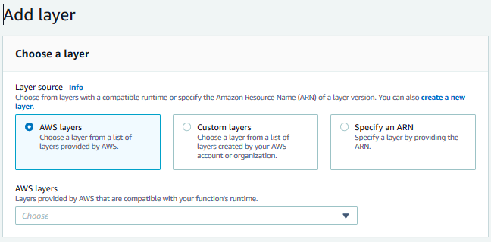
Creating layers
AWS managed layers
Partner or third-party layers
Notes:
|
Your libraries, dependencies to your code, or custom runtimes can be zipped as part of your build-and-deploy process of your Lambda function. However, this means that you cannot easily share those libraries, dependencies, or runtimes with other functions, other AWS accounts, or a third party. It also means that you cannot easily make changes and have those changes propagate to all the functions that use these items.
You can create one or more layers to package shared dependencies. You can include up to five layers per function, which count towards the standard Lambda deployment size limits.

Slide 38
Test
Module 9: Processing Your Application Logic

Slide 39


Test and debug
Test and debug the application
Function code
Deployment package
Layer 1
Layer 2
Layer
Notes:
Upload your deployment package. Separate shared dependencies and upload them as a layer. This way, you can test your function code more effectively.

Slide 40
Testing objectives
Performance test your Lambda function for memory
Load test your Lambda function for timeouts
Understand Lambda limits
Notes:
Performance testing your Lambda function is crucial to making sure you choose the optimal memory size configuration. Any increase in memory size initiates an equivalent increase in CPU available to your function. The memory usage for your function is determined per invoke and can be viewed in CloudWatch Logs.
Load test your Lambda function to determine an optimal timeout value. It is important to analyze how long your function runs. By doing this, you can better determine any problems with a dependency service that might increase the concurrency of the function beyond what you expect. This is especially important when your Lambda function makes network calls to resources that may not handle Lambda's scaling.
Understand Lambda limits. For more information, see “Lambda quotas” in the AWS Lambda Developer Guide (https://docs.aws.amazon.com/lambda/latest/dg/limits.html).

Slide 41
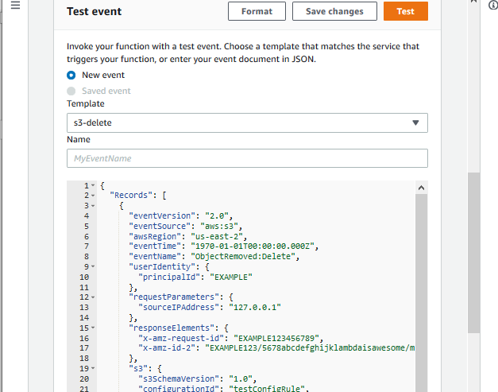
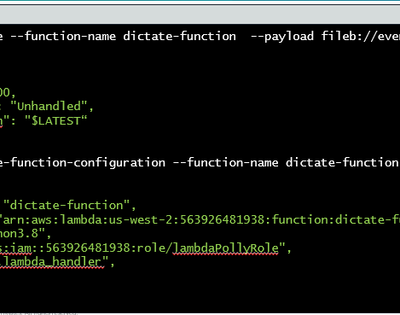
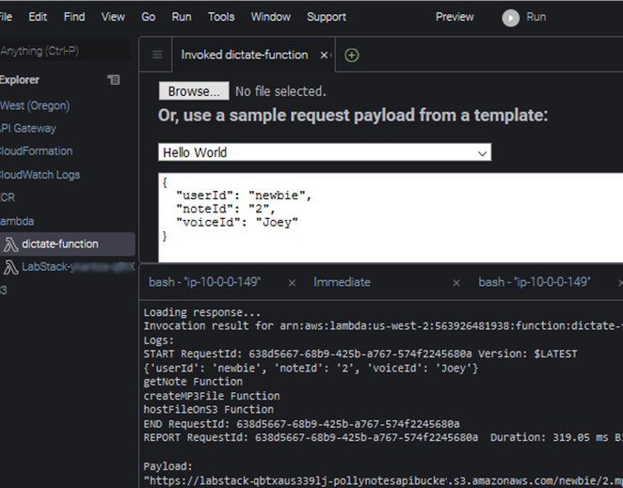

Testing a Lambda function
AWS Management Console
AWS Command Line Interface (AWS CLI)
AWS Software Development Kits (AWS SDKs)
AWS Serverless Application Model (AWS SAM)
Notes:
You can test Lambda functions in several ways:
AWS Management Console
Event templates
Custom payload
Use CloudWatch Logs: log group and a log stream
AWS CLI
Invoke the function or a version of it
Monitor through CloudWatch Logs
AWS Software Development Kits
AWS Toolkits with your IDE
Run functions locally or remotely. Running locally requires configuring the runtime environment.
AWS Serverless Application Model (AWS SAM)
AWS SAM with AWS toolkits and debuggers to test and debug locally
Consistently provision resources in multiple environments

Slide 42
Invoke a Lambda function
invoke
--function-name <value>
[--invocation-type <value>]
[--log-type <value>]
[--client-context <value>]
[--payload <value>]
[--qualifier <value>]
<outfile>
Function name, function ARN, or partial ARN
Event, RequestResponse, or DryRun
JSON input to function. Example:
{
"UserId": "newbie",
"NoteId": "2",
"voiceId": "Joey"
}
Function name
Function qualified ARN
arn:aws:lambda:aws-region:acct-id:function:dictate-function:42
Partial ARN
Qualifier (version number)
Notes:
When you invoke a Lambda function, you provide some information. At a minimum, you need the function name, the function’s ARN, or the function’s partial ARN. If you are invoking a specific version number, qualify the ARN with the version prefix. Other parameters you can invoke the function with include:
invocation-type – Specifies how your function should run.
Event: Asynchronous
RequestResponse: (default invocation) Synchronous
DryRun: Do not run the function but perform some checks, such as checking if the caller has permissions and if the inputs are valid.
log-type – If the invocation type is RequestResponse, set to Tail to include the execution log in the response. This populates the x-amz-log-result header with log data from your function.
client-context – In a JSON format, pass client-specific information that you can then process through the context variable.
Payload – A JSON input to the function, for example: {"UserId": "newbie", "NoteId": "2", "voiceId": "Joey"}.
Qualifier – Invoke a specific version of the Lambda function using the version number, or alias. To invoke the most current version of the Lambda function, qualify the functions ARN with $LATEST, or keep the ARN unqualified. For example, in this function qualified ARN, arn:aws:lambda:aws-region:acct-id:function:dictate-function:42, dictate-function is the function name, and 42 is version number qualifier.
Outfile – File name where the output content will be saved.

Slide 43
Example: Invoke a function
Function name
Payload
Terminal X
>> aws lambda invoke --function-name dictate-function --payload '{"UserId": "newbie","NoteId": "2","VoiceId": "Joey"}' response.txt
{ "ExecutedVersion": "$LATEST",
"StatusCode": 200
}
Response captured in a file.
Response.txt stores the location of an MP3 file.

Slide 44
Error handling
Invocation errors
Response error codes: 400 or 500 series
Common error types
Request
Too large or invalid
Caller
Missing permission
Account
Max function instances reached
Too many requests (1,000 concurrent run limit)
Function errors
Response header: X-Amz-Function-Error
Function errors
Determine error handling strategy
Runtime errors
Timed out
Syntax error
Notes:
Invoking a function can cause two types of errors:
Invocation errors are caused when an invocation request is rejected before your function receives it.
Function errors are caused by the function code or the runtime.
To avoid errors because of the account’s 1,000 concurrent run limit and to minimize throttling, you can reserve part of that concurrency for your Lambda.
If your system depends on retries, make sure that your code is idempotent. This means that it can be retried multiple times without causing duplicate transactions or other unwanted side effects.

Slide 45
Deploy
Module 9: Processing Your Application Logic

Slide 46
Packaging considerations
Control the dependencies in your function's deployment package
Minimize your deployment package size to its runtime necessities
Minimize the complexity of your dependencies
Container image
Create a Lambda function
Zip package
Notes:
Lambda supports two types of deployment packages: container images and .zip file archives.
Control the dependencies in your function's deployment package
The AWS Lambda runtime environment contains a number of libraries, such as the AWS SDK for the Node.js and Python runtimes. For more information, see “Lambda runtimes” in the AWS Lambda Developer Guide (https://docs.aws.amazon.com/lambda/latest/dg/lambda-runtimes.html).
To enable the latest set of features and security updates, Lambda will periodically update these libraries. These updates may introduce subtle changes to the behavior of your Lambda function. To have full control of the dependencies that your function uses, package all of your dependencies with your deployment package.
Minimize your deployment package size to its runtime necessities
Minimizing your deployment package size reduces the amount of time that it takes for your deployment package to be downloaded and unpacked ahead of invocation. For functions authored in Java or .NET Core, avoid uploading the entire AWS SDK library as part of your deployment package. Instead, selectively depend on the modules that pick up components of the SDK that you need. Examples are DynamoDB, Amazon S3 SDK modules, and Lambda core libraries.
Minimize the complexity of your dependencies
Aim for simpler frameworks that load quickly on Execution Context startup. For example, use simpler Java dependency injection (IoC) frameworks such as Dagger or Guice, over more complex ones, such as Spring Framework.

Slide 47
Deploy .zip file archives
Deploy .zip per language | Node.js, Python, Ruby | Java | .NET Core
What | ZIP archive consisting of your code and any dependencies | Zip file with all code and dependencies or standalone .jar | Zip file with all code or dependencies or a standalone .dll
How | Use npm , pip, or other build/packaging tool to install libraries | Use Maven, Eclipse IDE plugins or other build/packaging tool | Use Nuget, Visual Studio plugins, or other build/packaging tool
Where | All dependencies must be at root level | Compiled class and resource files at root level, required jars in /lib directory | All assemblies (.dll) at root level
Notes:
Node.js, Ruby, and Python
To create a Lambda function, you first create a Lambda function deployment package, a .zip archive file that consists of your code and any dependencies. Also, set the appropriate security permissions for the zip package.
Zip the directory content contained in the directory, not the directory itself. The contents of the .zip file are available as the current working directory of the Lambda function. For example: /project-dir/codefile.py/lib/YourLibraries. In this case, you zip the content contained in /project-dir.
Java
You decide whether your deployment package is a .zip file or a standalone jar. You can use any build and packaging tool you are familiar with to create a deployment package.
C#
A .NET Core Lambda deployment package is a .zip file of your function's compiled assembly along with all of its assembly dependencies. The package also contains the following:
proj.deps.json file, which signals to the .NET Core runtime all of your function's dependencies
proj.runtimeconfig.json file, which is used to configure the .NET Core runtime
The .NET publish command can create a folder with all of these files. However, the proj.runtimeconfig.json is not included by default because a Lambda project is typically configured to be a class library. To force the proj.runtimeconfig.json to be written as part of the publish process, pass in the following command line argument to the publish command:
/p:GenerateRuntimeConfigurationFiles=true

Slide 48
Deploy using containers
Create your project and code
Build container using base image from AWS
(Lambda Runtime Interface Client)
Upload container to Amazon ECR (10 GB)
Create Lambda function using container image
Notes:
To create your container image, you can use any development tool that supports one of the following container image manifest formats:
Docker image manifest V2
Schema 2 (used with Docker version 1.10 and newer)
OCI specifications (v1.0.0 and later)
For example, you can use the Docker CLI to build, test, and deploy your container images. Base images are provided for all supported Lambda runtimes, and even custom runtimes such as images based on Alpine or Debian Linux.
To work with Lambda, these images must implement the Lambda Runtime API. To make it easier to build your own base images, AWS provides Lambda Runtime Interface Client when implementing the Runtime API for all supported runtimes. These implementations are available through native package managers so you can easily pick them up in your images. The implementations are shared with the community using an open source license.
Container images do not use layers. Instead, container images package the needed runtime, libraries, and other dependencies into the container image being built.

Slide 49
Lambda function limits
Resource | Quotas (as of Sept 2021)
Memory allocation | 128 MB to 10,240 MB
Max runtime (Time out) | 15 minutes
Burst concurrency | 500–3000 (varies by Region)
Invocation payloads | Synchronous: 6 MB Asynchronous: 256 KB
Deployment package | Zip: 50 MB; unzipped: 250 MB; from console: 3MB Container image: 10 GB
/tmp directory storage | 10 GB
Notes:
Your functions' concurrency is the number of instances that serve requests at a given time. A sudden increase in the number of instances needed to fulfill the requested number of running functions is referred to as a burst.
For more information, see “Lambda quotas” in the AWS Lambda Developer Guide (https://docs.aws.amazon.com/lambda/latest/dg/gettingstarted-limits.html).

Slide 50
Demo
Module 9: Processing Your Application Logic

Slide 51

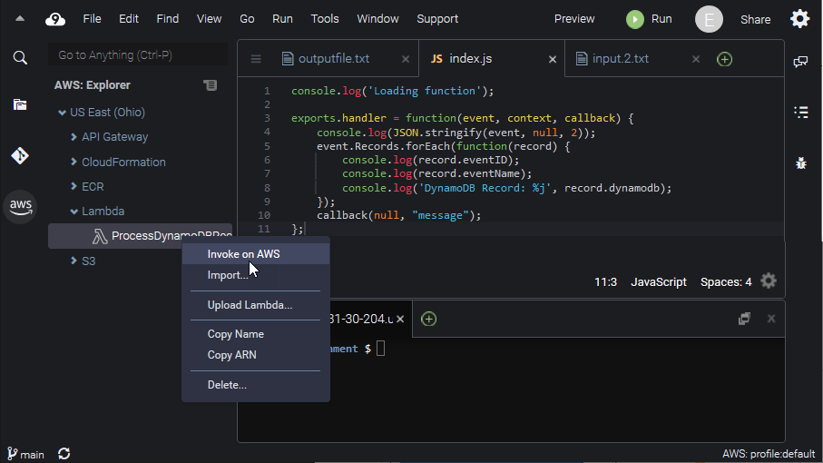
Create a Lambda function with Cloud9
Overview of the Lambda environment
Using global/scope constraints – Environment variables and parameters
Deploying versions, aliases, and Lambda layers
Using Cloud9, SDK toolkits
Monitoring using CloudWatch

Slide 52
Check your knowledge
Module 9: Processing Your Application Logic

Slide 53
Knowledge check
1
☑
☒
☒
☑ True
☒ False
The AWS Lambda service handles servers, capacity, and deployment needs for you.
2
Your AWS Lambda function needs Invocation permissions to access other AWS resources in your account.
3
Developing and creating a Lambda function is possible only through the AWS Lambda console.
4
☑
☑
☑
If you enable DynamoDB Streams on a table, you can associate the stream ARN with a Lambda function that you write.
5
Each Lambda function runs in its own isolated environment, with its own resources and file system view.
6
AWS Lambda’s programming model is stateless, but it can still access stateful data.
Notes:
(True)
(False) Your AWS Lambda function needs processing permissions to access other AWS resources in your account.
(False) In addition to the AWS Lambda console, you can use the AWS CLI. You can also interact with your custom code using AWS SDKs. Further, both Eclipse and Visual Studio toolkits support the development of Lambda functions.
(True)
(True)
(True) Although AWS Lambda’s programming model is stateless, your code can access stateful data by calling other web services, such as Amazon S3 or Amazon DynamoDB.

Slide 54
Lab 4: Develop Solutions Using AWS Lambda
Module 9: Processing Your Application Logic

Slide 55


Lab 4 overview: Develop Solutions Using AWS Lambda
List
Create/update
User
Search
Notes table
Delete
Dictate
MP3
hosting
Amazon Polly
Notes:
|
Lab objectives After completing this lab, you will be able to:
Create AWS Lambda functions and interact programmatically by using the AWS SDK and the AWS CLI.
Configure AWS Lambda functions to use environment variables and integrate with other services.
Generate Amazon S3 presigned URLs by using the AWS SDK and verify access to bucket objects.
Deploy the Lambda functions with .zip file archives, and test as needed.
Invoke Lambda functions with multiple invocation options from the AWS Management Console and AWS CLI.

Slide 56
Wrap-up
Module 9: Processing Your Application Logic

Slide 57
Module summary
You are now able to:
Explore how AWS Lambda works
Develop an AWS Lambda function using SDKs
Configure triggers and permissions for Lambda functions
Test, deploy, and monitor Lambda functions

Slide 58
Thank you

